Slide 1
Restaurant Management system
Name: mD. Tasiful Alam (2018-1-60-171)
Name: SaRDER IFTHEKHAR AHMED(2018-1-60-181)
Name: MD. NURUL ABRAR(2018-1-60-139)

Slide 2
INRODUCTION:
Restaurant Management system is an application system which are generally small or medium in size. It is basically used by restaurants to manage the restaurants record using the employee details, customer details address, order details, item list, discount, delivery man details, customer rank etc. It uses different entities to provide best service to customer.

Slide 3
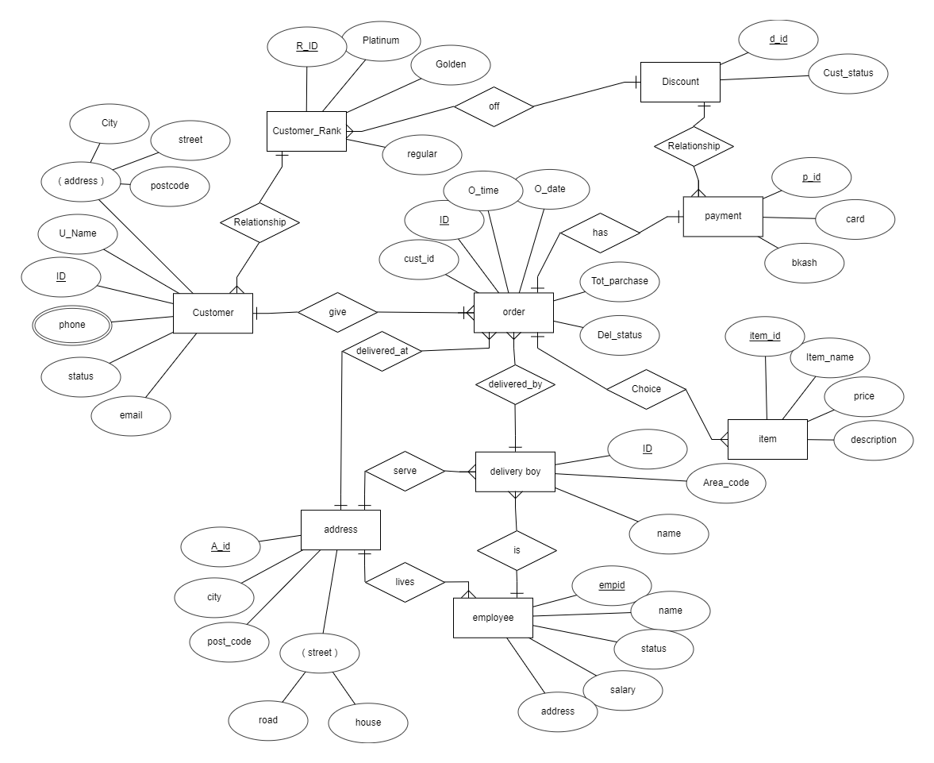
ER-DIAGRAM:
An Entity Relationship Diagram (ERD) is a visual representation of different entities within a system and how they relate to each other.

Slide 4
As seen on figure above the ER diagram has Nine entities :
Customer
Address
Employee
Delivery boy
Item
Payment
Discount
Order
Customer rank

Slide 5
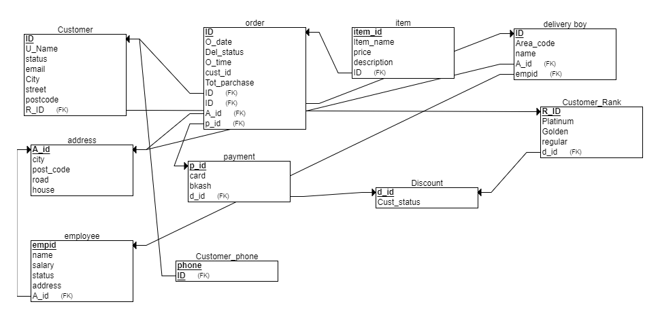
RELATIONAL SCHEMA:
A schema is the structure behind data organization. It is a visual representation of how different table relationships enable the schema’s underlying mission business rules for which the database is created. Database schema defines its entities and the relationship among them.

Slide 6
Responsibility:
Name: MD. Tasiful Alam (sql and ppt)
Name:Sarder Ifthekhar Ahmed (Er diagram and design description)
Name: MD. Nurul Abrar (report)

Slide 7


